Slide 1
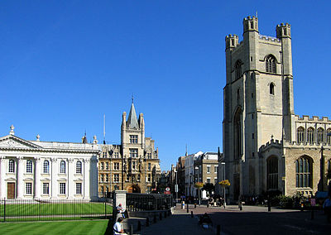
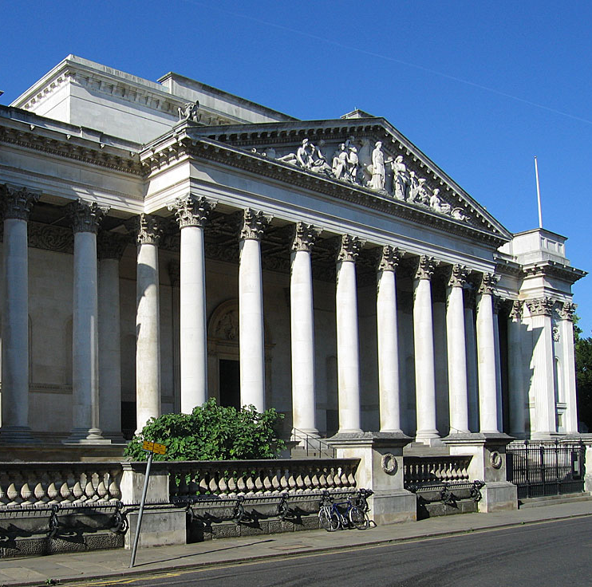
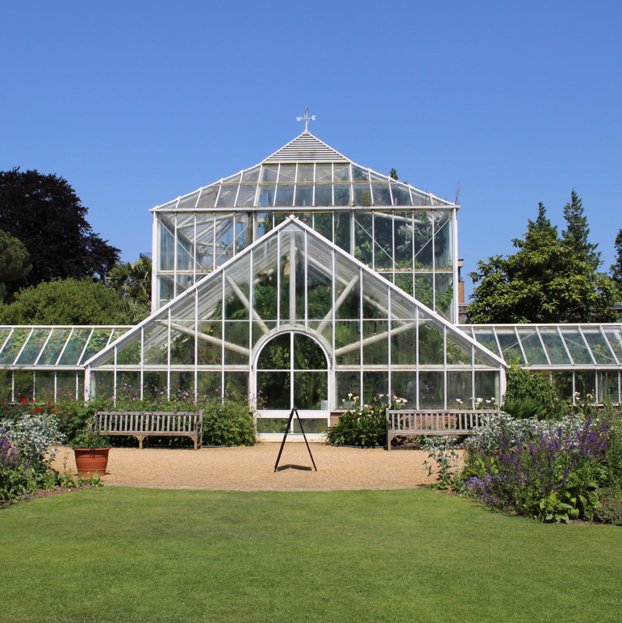
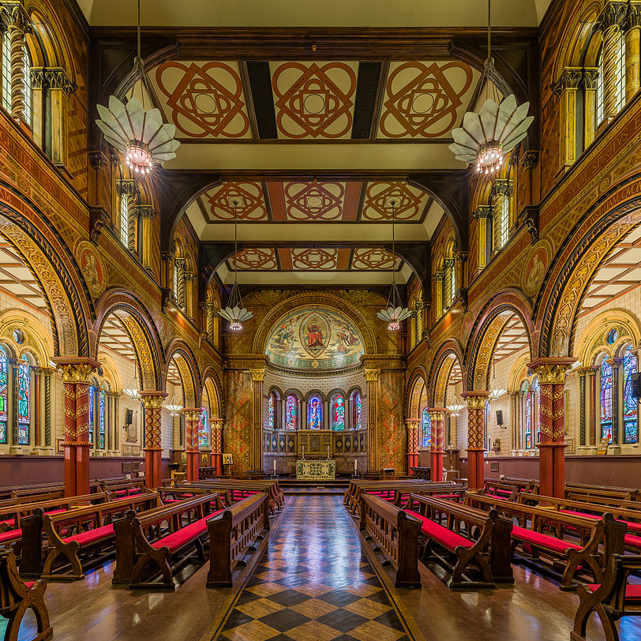
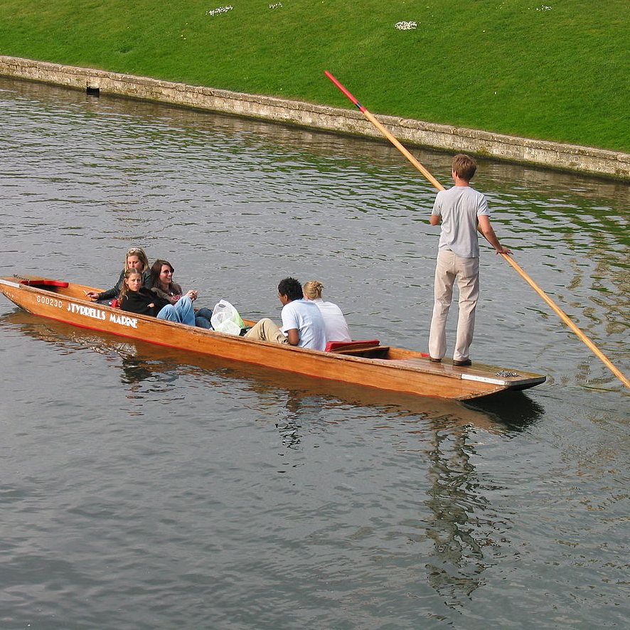
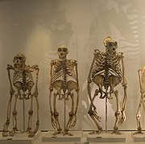
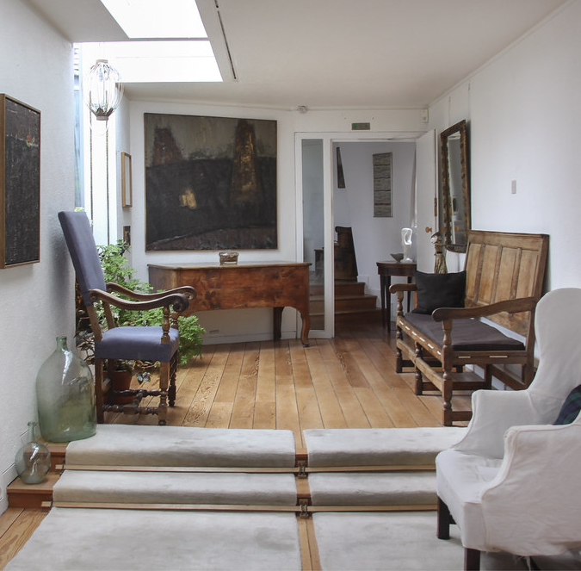
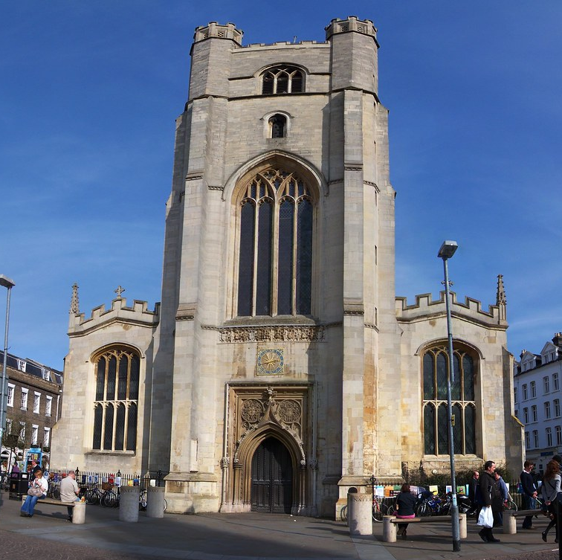
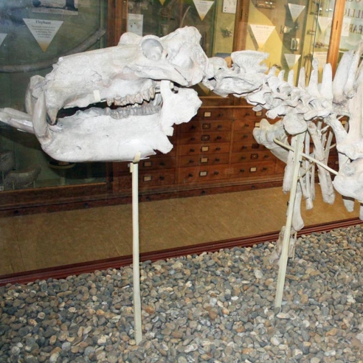
FREE TIME ACTIVITIES
NOVEMBER 2020
Every Monday:
Walking tour around Cambridge City Centre
LOCAL CAMBRIDGE ATTRACTIONS
Fitzwilliam Museum
fitzmuseum.cam.ac.uk
The Botanic Gardens
botanic.cam.ac.uk
King’s College Chapel
kings.cam.ac.uk
Punting on the River Cam
scudamores.com
Museum of Zoology
museum.zoo.cam.ac.uk
Kettle’s Yard
Art Gallery
kettlesyard.co.uk
Great St
Mary’s Church
gsm.cam.ac.uk
Sedgwick Museum of Earth Sciences
sedgwickmuseum.org
ONLINE EVENTS
Monday 9th November
6pm – 7pm
Larmor Lecture:
Climate change and cascading risks
More information here:
http://www.cambridgephilosophicalsociety.org
Thursday 19th November
7pm – 8.15pm
Richard Dawkins on the meaning of life
More information here:
https://howtoacademy.com/events/richard-dawkins-on-the-meaning-of-life/
Thursday 26th November
6pm – 7.30pm
Slowing the Spread: How genomics can help us understand COVID-19
More information here:
https://publicengagement.wellcomegenomecampus.org/genome-lates-a-special-human-genome-project-anniversary-season

