Slide 1
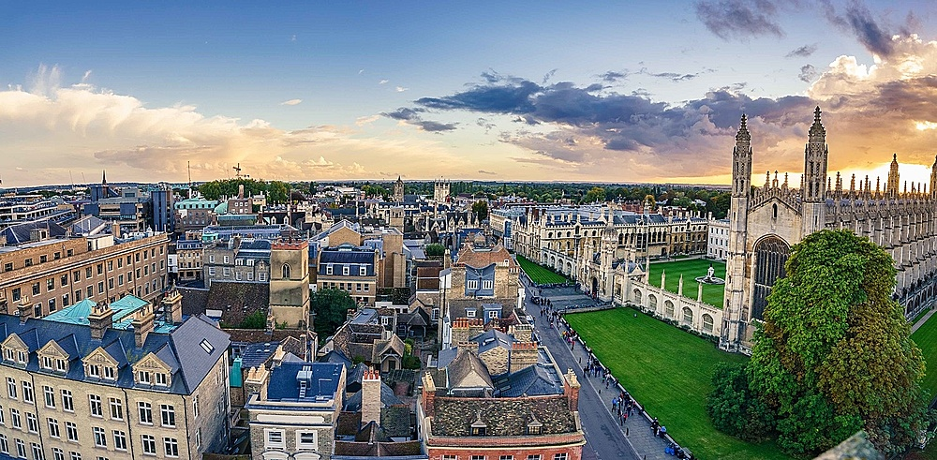
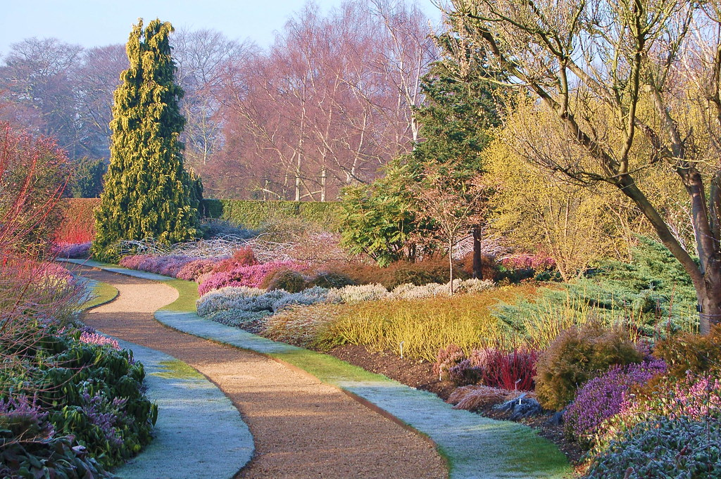
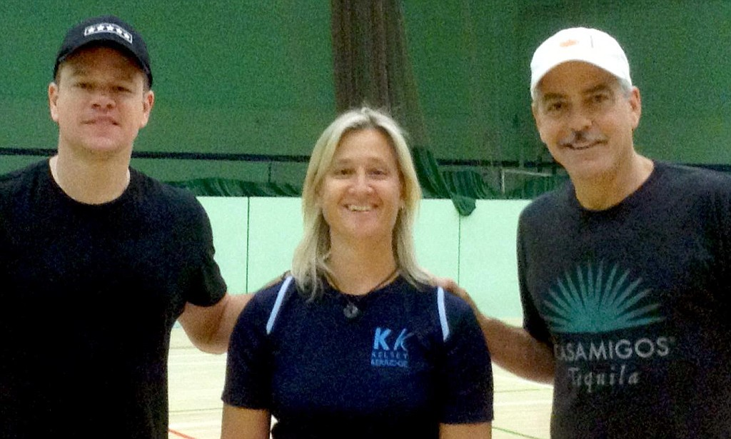
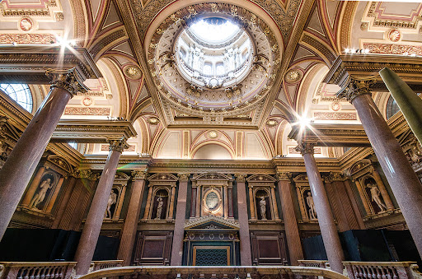
SOCIAL PROGRAMME
APRIL 2024
Every
Monday
3.25pm
Every Monday
3:25pm
Wednesday
03 Apr
15:25pm
Friday
05 Apr
13:45pm
Wednesday
10 Apr
15:25pm
Friday
12 Apr
13:45pm
Wednesday
17 Apr
3:25pm
Friday
19 Apr
13:45pm
Wednesday
24 Apr
15:25pm
Friday
26 Apr
13:45pm
Walking tour
Price: Free
Cambridge has lots to see and do including museums, colleges and shopping malls. We’re offering a walking tour every Monday which starts from the school and finishes in the city centre close to the shopping centre and bus station.
Sports Afternoon
Price: 5
If you like to play football,
Volleyball, basketball or Badminton, you can join us and play your favourite sport with your classmates in Kelsey Kerridge (where George Clooney and Matt Damon played a few sports).
Fitzwilliam Museum
Price: Free It is Cambridge’s largest museum that houses artefacts and art from around the world. Highlights include Egyptian coffins, impressionist masterpieces and Renaissance sculpture.
Arts and Crafts
Price: £2 Arts and Crafts is an activity that enables students to get together in Café Studio and share their creativity by making nice and interesting things. If you would like to join, please come to reception!
Punting
Price: £15
The Cambridge experience is not complete if it doesn’t include punting on the river Cam. You get to see the amazing Colleges from The Backs and take nice pictures to immortalise this experience. If you want to sign up, please come to reception.
Botanic Gardens
Price: £8
The Botanic Gardens is one of the most impressive displays of plants and flowers that you will ever see - and it is very close to Studio Cambridge! If you want to sign up, please come to reception.
Museum of Archaeology and Anthropology
Price: Free Founded in 1884, M.A.A. houses collections of local antiquities together with archaeological and ethnographic artefacts from around the world.
Museum of Zoology
Price: Free
The Museum of Zoology is one of Cambridge's major attractions. The brilliant galleries showcase the diversity of animal life, from marsupials to monkeys, mammoths to manatees. Join us to explore this fascinating museum.
King’s College
Price: 15
A popular tourist attractions. Completed by Henry VIII in 1544 this fine example of neo-Gothic architecture in steeped in Tudor history and symbology. You’ll be able to enjoy the biggest Chapel in the world, including some of the amazing stained glass.

